Slide 1
Data Analysis in Criminal Justice
Measures of Central Tendency; Measures of Dispersion

Slide 2
Review of Order of Operations
P.E.M.D.A.S.
Parentheses, exponents, multiplication & division, addition & subtraction
4 + 2 X 3 ≠ (4 +2) X 3
4 + 2² ≠ (4 + 2)²
For multiplication & division (as well as addition & subtraction), just work from left to right
15 / 3 X 4 ≠ 15 / (3 X 4)

Slide 3
Measures of Central Tendency
Describing a data series
What is central tendency?
Mode, median, & mean
A note on rounding
Evaluating skewness
Least squares property of the mean

Slide 4
Describing a Data Series
n is sample size (also, N)
Raw data (x₁, x₂, x₃…., x_{n})
x_{i} denotes a single observation, where I = 1,2,3,….,n
Summation operator:
Tells you to add up all of the values of x from obs. 1 to obs. n

Slide 5
What is Central Tendency?
Single number that represents the most common or “typical” score around which others in the distribution tend to cluster.
Three different measures:
Mode: The most frequently occurring value
Median: Value in the middle of the distribution
Mean: Arithmetic average of a distribution

Slide 6
Mode
Qualitative Data
Mode is a category
Quantitative Data
Mode is a value
Advantages
Simple to compute; frequency distribution only
Used with all types of data & the only measure that can be used with nominal data.
Disadvantages
Fails to take into account data values
Not very useful with data other than at the nominal and ordinal levels

Slide 7
Median
Value or score that divides a rank-ordered distribution exactly in half
50th percentile
“Positional” measure of central tendency
The middle score
Require ordinal data or higher

Slide 8
Median (cont.)
Advantages
Only one median in any data set (unlike mode)
Will often be a value that exists in the data
Not sensitive to extreme scores
Disadvantages
Still does not take into account values, only their relative positions

Slide 9
Calculating the Median from Raw Data
1) Arrange the data in ascending order
2) Find the median position (MP) using the formula (n + 1) / 2
3) Count up to identify the value (or midpoint between two values) in this position
Important: The median is the value in the position, not the position itself.

Slide 10
Calculating the Median from a Frequency Distribution
Add a cumulative frequency column to the table and proceed as usual.
Compute MP = (n + 1) / 2
Identify the value (or midpoint) in this position
Or, use cumulative percent/proportion
Identify the first value with a cumulative percent greater than 50%
If exactly 50%, take the midpoint of that value and the next one

Slide 11
Mean
Most common measure of central tendency
Requires interval data or higher
“Balancing” score
Positive differences cancel out negative differences
Known as the “least squares” property

Slide 12
Mean (cont.)
Advantages
Desirable mathematical properties
Least squares, minimum variance
Stable measure of central tendency
Utilizes all information provided in the data
In other words, it takes into account the values
Disadvantages
Only useful for quantitative (interval-ratio) data
Is not always a value that exists in the data
Sensitive to extreme scores, or “outliers”

Slide 13
Calculating the Mean
1) Add up all of the values of x
2) Divide by the number of observations

Slide 14
A Note on Rounding
Round your final answers to at least one additional decimal unit than contained in the original values.
# of drinks consumed: 4,2,3,8,6,6
Mean = 29 / 6 = 4.8333 = ~4.8
Do not round off your calculations at each intermediate step; wait to round until your final answer if possible
Cumulative rounding error can be problematic

Slide 15
A Note on Rounding (cont.)
Decide how many decimal places you want to round your answer to
Look at the digit to the right of the last decimal place that you want to keep
If the digits are larger than .5, round up
If the digits are smaller than .5, round down
If the digits are exactly .5, look at the interval place that you want to round
If the digit is even, round up (2.85 → 2.9)
If the digit is odd, round down (6.35 → 6.3)

Slide 16
Rounding Examples
Round each of these figures to two decimal places using the rounding rule
12.57499
5.415
6.44500
10.826
5.999

Slide 17
A Simple Example
Data series (n = 10):
1 2 3 4 5 6 7 8 9 10
Mode = not defined
Median
Median position = (10 + 1) / 2 = 5.5th position
Median = (5 +6) / 2 = 5.5
Mean = 55 / 10 = 5.5

Slide 18
Another Simple Example
Data series (n = 15):
1 1 1 2 2 3 4 4 4 4 4 5 5 6 6
Mode = 4
Median
Median position = (15 +1) / 2 = 8th position
Median = 4
Mean = 52 / 15 = 3.46666667 = 3.5

Slide 19
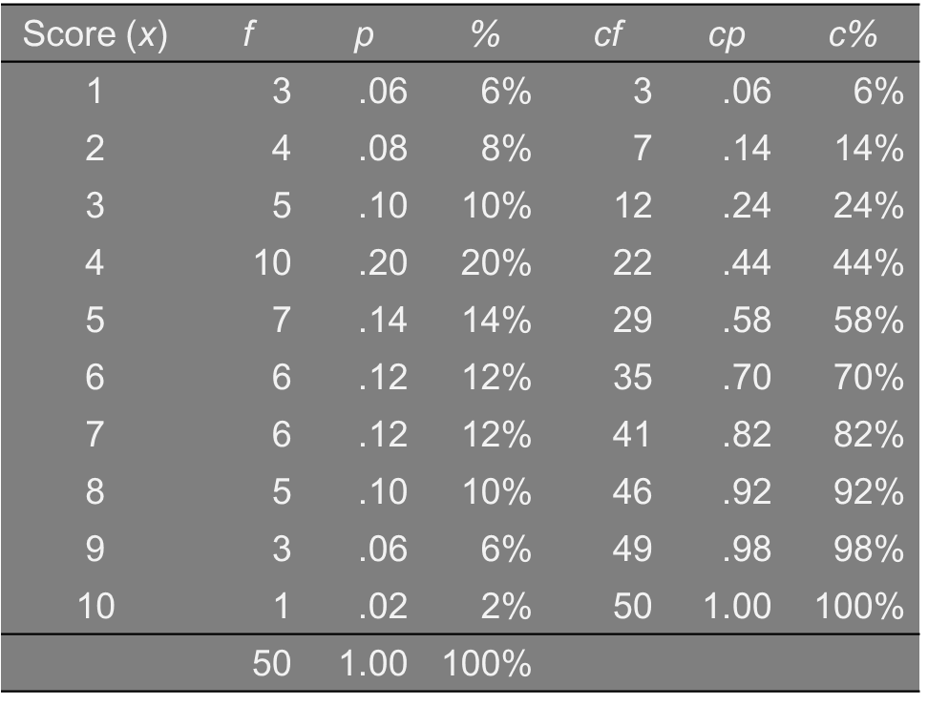
Frequency Distributions
Mode & Median?

Slide 20
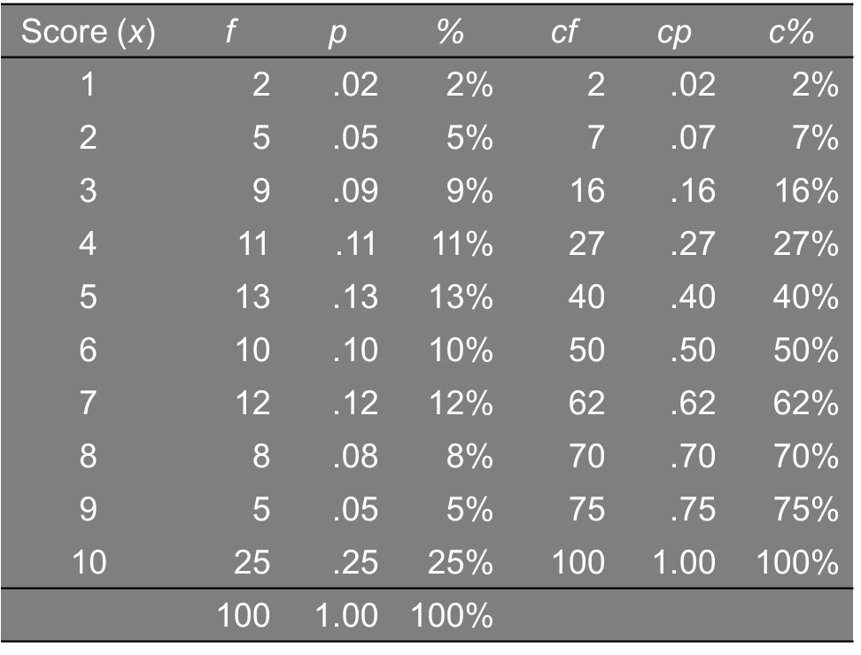
Frequency Distributions (cont.)
Mode & median?

Slide 21
Computing a Mean from a Frequency Distribution
Weighted Mean
Where ‘w’ is the “weight” assigned to each observation
With raw (i.e., unweighted) data, each observation is assigned a weight of one, so…

Slide 22
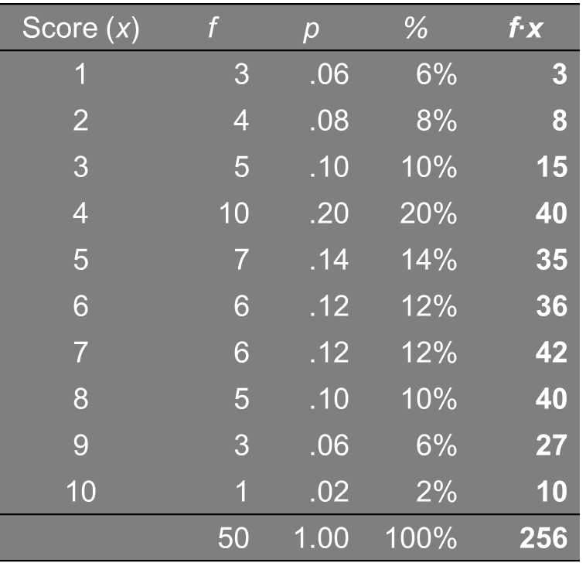
Frequency Distributions
Mean using frequencies as weights

Slide 23
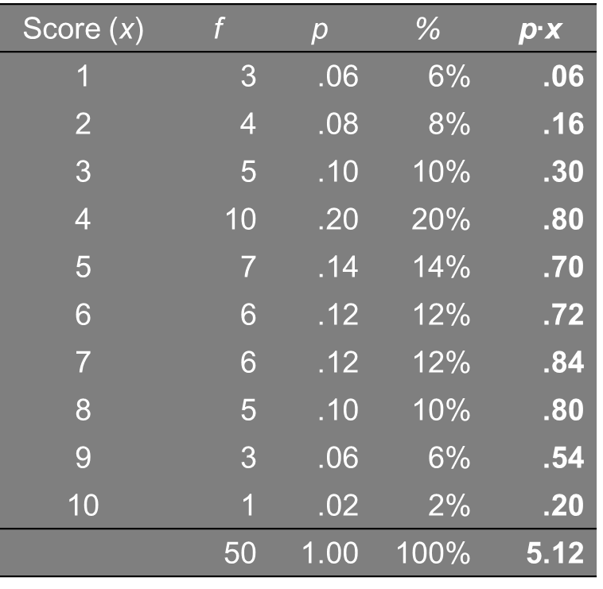
Frequency Distributions
Mean using proportions as weights

Slide 24
North Carolina Index Offenses
Offenses Reported to Police, 2016
What measures of C.T. are appropriate?
Type of Offense | f | p
Murder | 678 | 0.002
Forcible Rape | 2849 | 0.009
Robbery | 9336 | 0.030
Aggravated Assault | 24906 | 0.079
Burglary | 72082 | 0.228
Larceny-Theft | 190377 | 0.603
Motor Vehicle Theft | 15306 | 0.048
 | 315534 | ~1.00

Slide 25
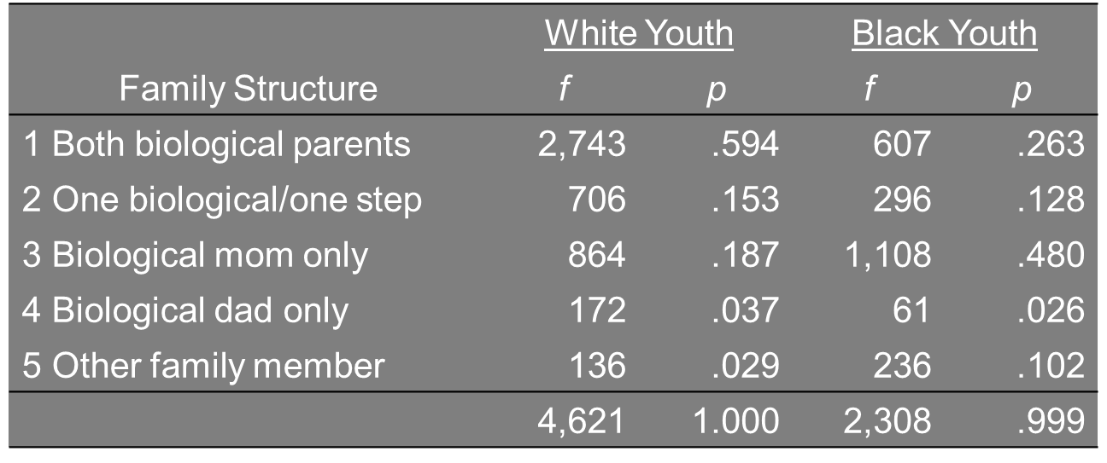
Family Structure
Relationship to parent figure(s)

Slide 26
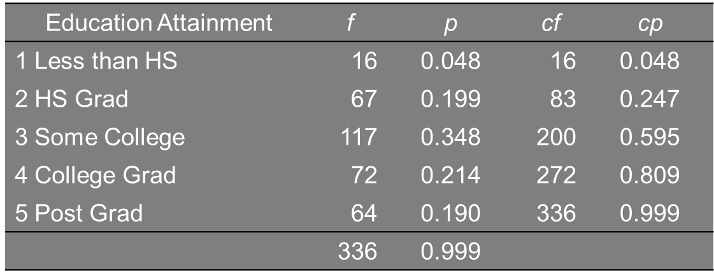
Educational Attainment
Educational attainment of police officers

Slide 27
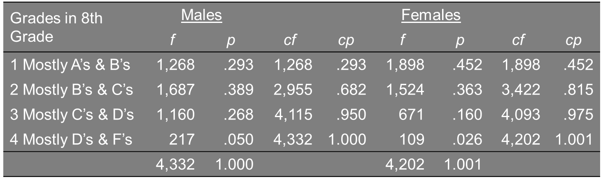
Scholastic Performance
Grades in the 8th grade

Slide 28
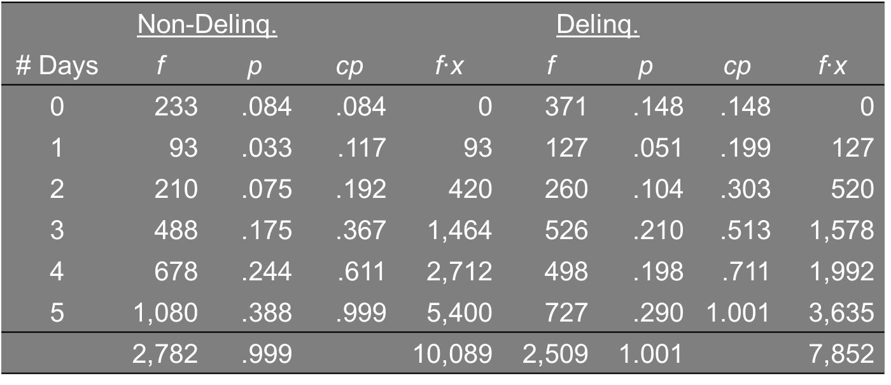
Time Spent on Homework
# of weekdays spent doing homework

Slide 29
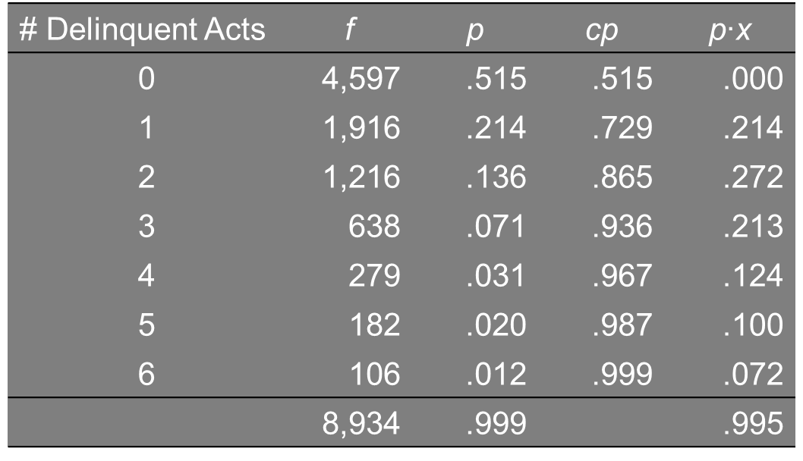
Juvenile Delinquency
Variety scale of six different delinquent acts youths have committed

Slide 30
Sentence Length
Sentence length in months for armed robbery (n = 40)
36 38 39 47 50 51 51 53 55 55 (sum = 475)
56 57 60 62 63 64 64 66 67 68 (sum = 627)
69 70 70 70 71 75 78 79 80 80 (sum = 742)
81 83 85 86 87 89 95 98 99 99 (sum = 902)
Mode = 70 [but not very informative]
MP = (40 + 1) / 2 = 20.5 → Median = (68 +69) / 2 = 68. 5
Mean = (475+627+742+902) / 40 = 2746 / 40 = 68.7

Slide 31
Unemployment Rate
State-level unemployment rate, 1998
2.4 2.4 2.5 2.5 2.7 2.9 2.9 3.0 3.0 3.0 (sum = 27.3)
3.1 3.3 3.4 3.5 3.6 3.6 3.6 3.7 3.7 3.8 (sum = 35.3)
3.9 3.9 4.0 4.0 4.1 4.2 4.2 4.2 4.3 4.3 (sum = 41.1)
4.3 4.5 4.5 4.6 4.6 4.7 4.8 4.8 4.9 4.9 (sum = 46.6)
5.2 5.3 5.3 5.5 5.6 5.7 5.7 5.9 6.3 6.3 (sum = 56.8)
Mode = 3.0, 3.6, 4.2, 4.3 [definitely uninformative]
MP = (50+1) / 2 = 25.5 → Median = (4.1+4.2) / 2 = 4.15
Mean = (27.3+35.3+41.1+46.6+56.8) / 50 = 207.1 / 50 = 4.14

Slide 32
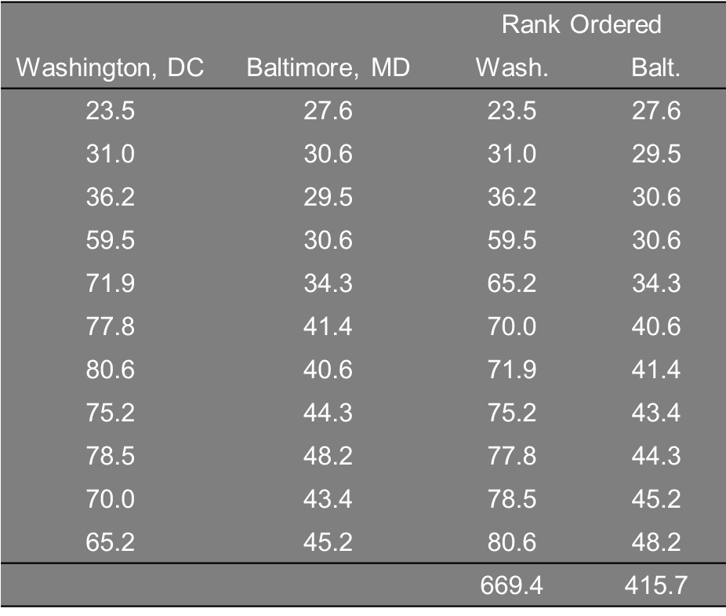
City Homicide Rates
Washington & Baltimore, 1985-1995 (n=11)
Washington’s mean homicide rate for this period was 61.0% higher than Baltimore’s: (60.85 – 37.79) / 37.79 = 23.06 / 37.79 = .610

Slide 33
Evaluating Skewness
With normally-distributed or mound-shaped data, the mode, median, & mean converge on the same value
This line represents the mode, median, & mean with perfectly normal data

Slide 34



Evaluating Skewness
With skewed data, one of the tails of the distribution is pulled
Right (positive) skew or left (negative) skew
Mean gets pulled away from the median
Mean is sensitive to outliers
Mode
Median
Mean

Slide 35
Skewed Data in Social Sciences
Examples of skewed variables
Income
# accidents
Crime rate
# arrests
Sentence length
Rule of thumb
If mean > median, then positive skew
If mean < median, then negative skew

Slide 36

Desirable Property of the Mean as a Measure of Central Tendency
Least squares or minimum variance
Positive deviations from the mean cancel out negative deviations
$\sum{\left(x−\overline{x}\right)=0}$
Squared deviations are smallest around the mean compared to any other fixed value
$\sum{{\left(x−\overline{x}\right)}^{2}=minimum}$
$\sum{{\left(x −\overline{x}\right)}^{2}< \sum{(x −median)²} }$

Slide 37
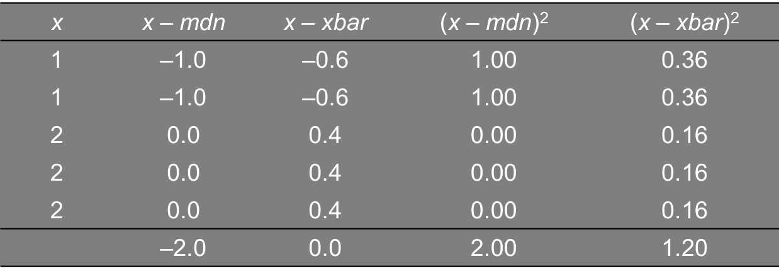
A Simple Example of Least Squares
Hypothetical data series (n = 5)
Mode, median = 2
Mean = 8/5 = 1.6
Sum of squared deviations from the mean is smaller (1.20) than the sum of squared deviations from the median (2.00)

Slide 38
Measures of Dispersion

Slide 39
Measures of Dispersion
Overview of dispersion
Dispersion in quantitative (I-R) data
Computational formula for variance
Parameters v. statistics

Slide 40
Overview of Dispersion
Central tendency: Value around which others tend to cluster
Provides a “best guess” of the single value that is most reflective of the data
Dispersion: How widely scores are scattered about the central score
Reflects the degree of uncertainty
How good of a guess is our “best guess”?

Slide 41
Overview of Dispersion (cont.)
Central tendency v. dispersion
Measures of central tendency are useful as stand-alone or absolute measures
Dispersion is easier to interpret when two or more groups are compared
Measures of dispersion are only useful as relative measures

Slide 42
Importance of Dispersion
Crossing a river but not a good swimmer
You know that the mean depth is 3 feet
Do you cross?
Mean says nothing about the depth of the river at any particular point
Measurement of depth at five-foot intervals
Scenario #1: 3 3 3 3 3 3 3 3 3 3
Scenario #2: 1 2 2 3 3 3 4 4 4 4
Scenario #3: 1 1 1 1 2 2 2 2 9 9
Scenario #4: 1 1 1 1 1 1 1 1 1 21

Slide 43
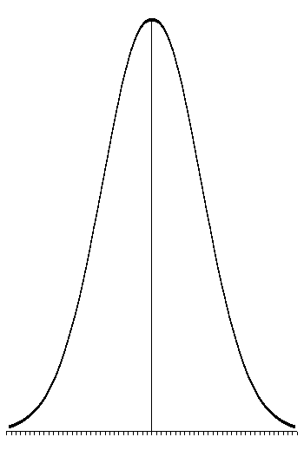
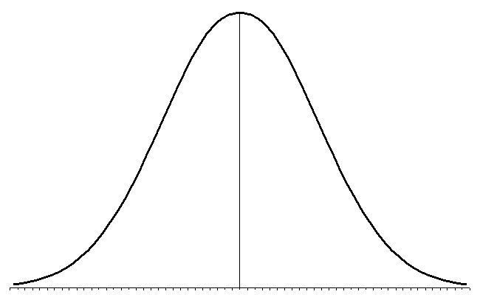
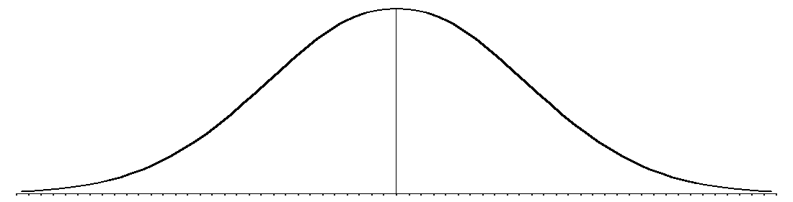
Comparing Distributions
The distribution of a variable with the same mean can look very different depending on the degree of variability
Small Variability
Large Variability

Slide 44
Measures of Dispersion
Qualitative data (nominal & ordinal)
Variation ratio (VR)
Quantitative Data
Range
Interquartile range (IQR)
Variance & standard deviation (s² & s)

Slide 45
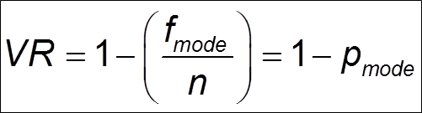
Variation Ratio
Proportion of cases that lie outside of the modal category
Counterpart to mode as measure of C.T.
Bound between 0.0 and 1.0
Can multiply by 100 to turn into a percentage
Not defined with bimodal distributions

Slide 46
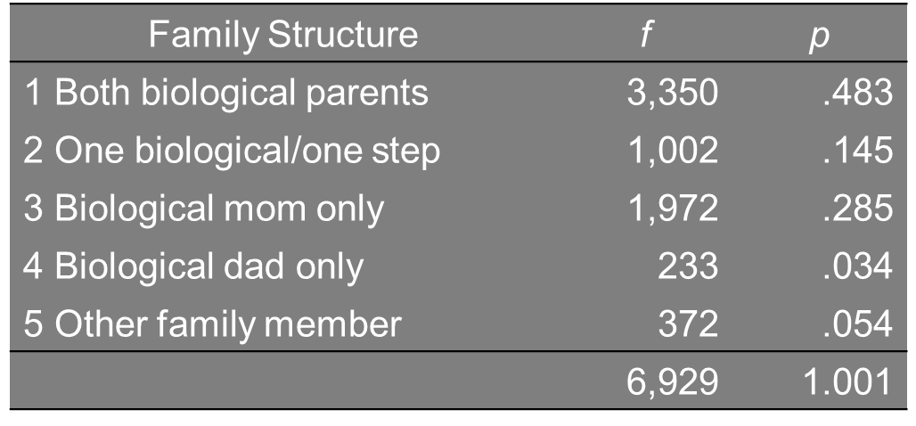
Variation Ratio (cont.)
Relationship to parent figure(s)
VR = 1 - .483 = .517
51.7% of cases are outside of the modal category

Slide 47
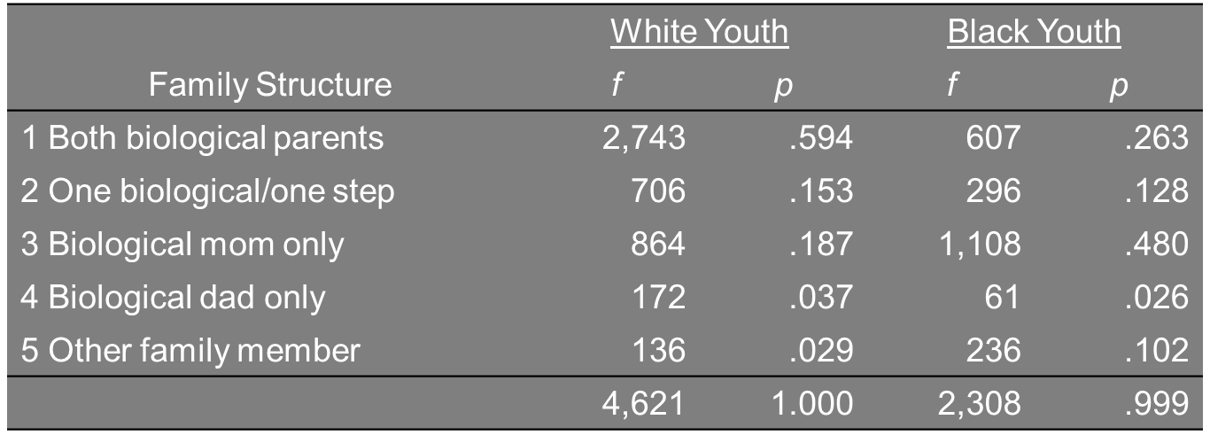
Variation Ratio (cont.)
Relationship to parent figure(s) by race
Which group has more variability?
VRw = .406 VRb = .520
Whites are more homogeneous than blacks

Slide 48

Interquartile Range
The range of the middle 50% of data
Counterpart to median as measure of C.T.
25th to 75th percentile
Less sensitive to outliers than range (xmax – xmin)
Calculating the IQR
1) Arrange the data in ascending order
2) Compute the MP & truncate it to get TMP
3) Find the quartile position QP = (TMP + 1) / 2
4) Count up from the lowest & down from the highest

Slide 49
Mean Deviation (MD)
Average deviation of scores about the mean
Calculating the MD
Calculate sample mean
Subtract mean from each score (“deviation”)
Sum up absolute deviations and divide by sample size

Slide 50
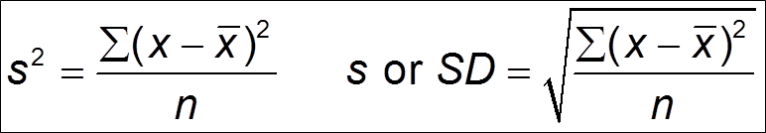
Variance & Standard Deviation
Variance (s²) = Average squared deviation of scores about the mean (s = SD)
Counterpart to mean as measure of C.T.
Calculating the variance
1) Calculate sample mean
2) Subtract mean from each score
3) Square the deviation score for each case
4) Sum up squared deviations and divide by n

Slide 51
More on Variance & Standard Deviation
Relies on “least squares” property of the mean as a measure of dispersion
Variance is at a minimum when taking squared deviations from mean v. any other value
Squaring the deviations “penalizes” outliers
But this changes the unit of measurement, giving it a cumbersome interpretation
We report standard deviation (s) more often

Slide 52
Note on Mean Deviation & Variance
Mean deviation
Average absolute deviation
Variance
Average squared deviation
MD applies equal weight to deviations, whereas s² “penalizes” large deviations

Slide 53
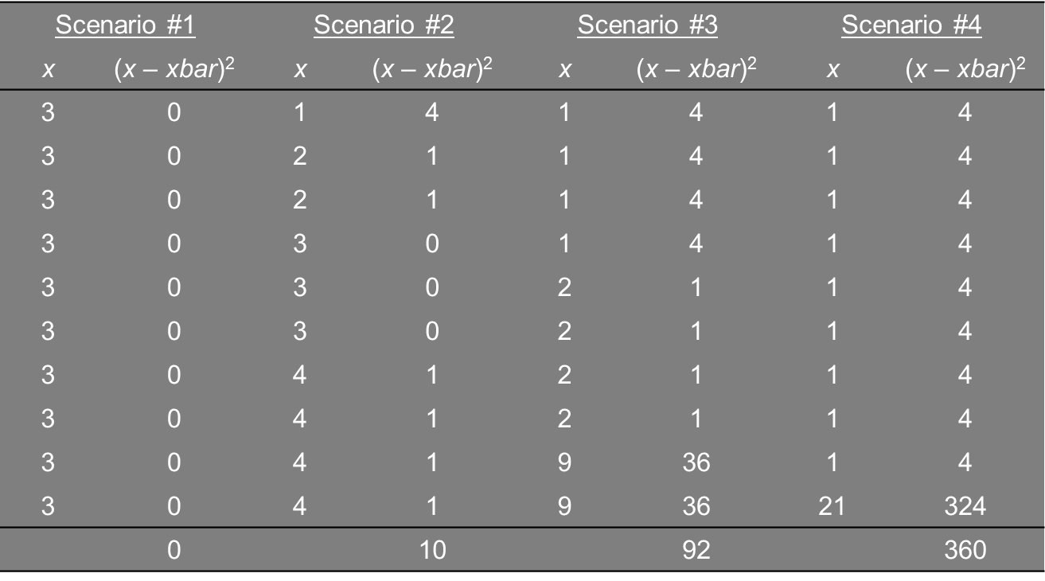
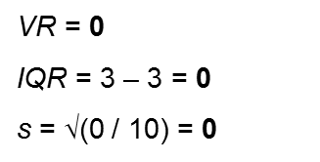
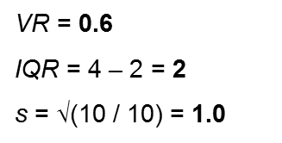
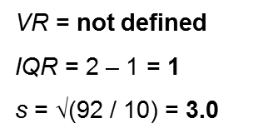
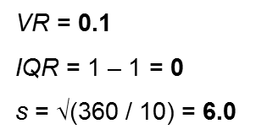
River Crossing Example

Slide 54
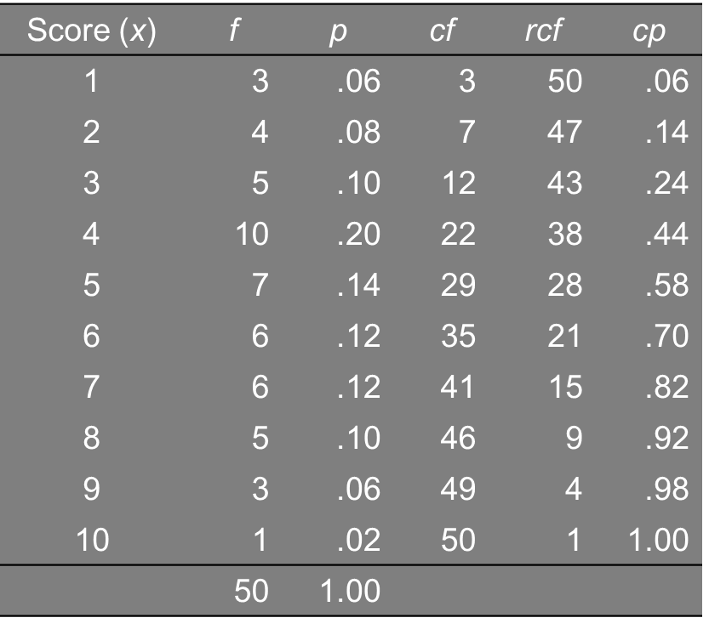
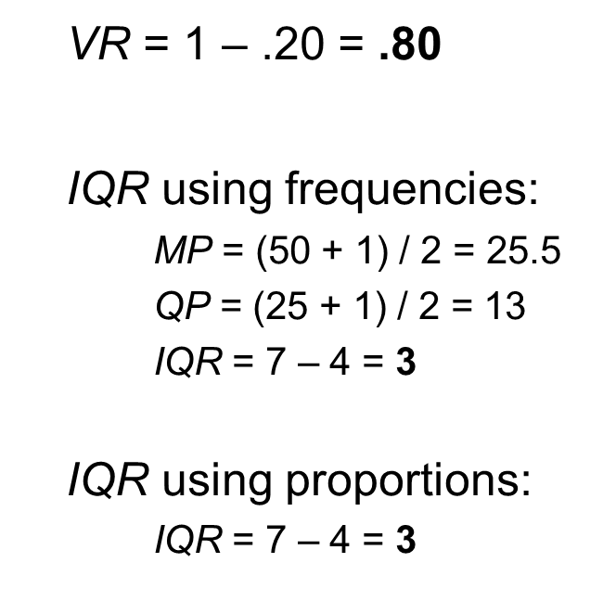
Frequency Distributions
Calculate variation ratio & interquartile range

Slide 55
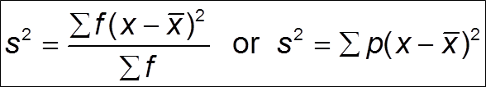
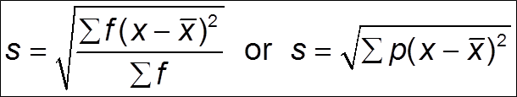
Frequency Distributions (cont.)
How can we calculate variance & standard deviation with frequency distributions?
Modify formulas to use frequencies (or proportions or percents) as weights

Slide 56
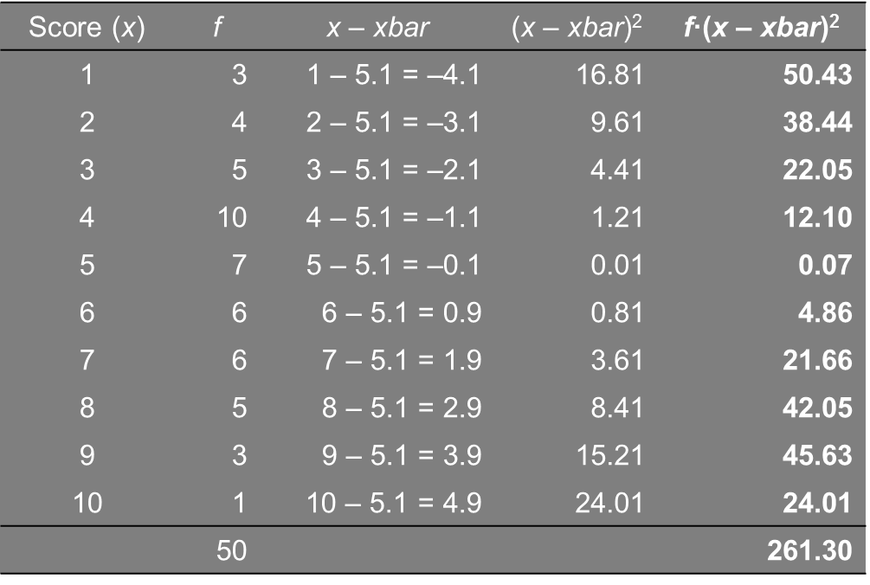
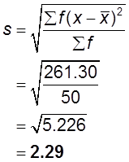
Frequency Distributions (cont.)
Calculate s using f’s (xbar = 5.1)

Slide 57
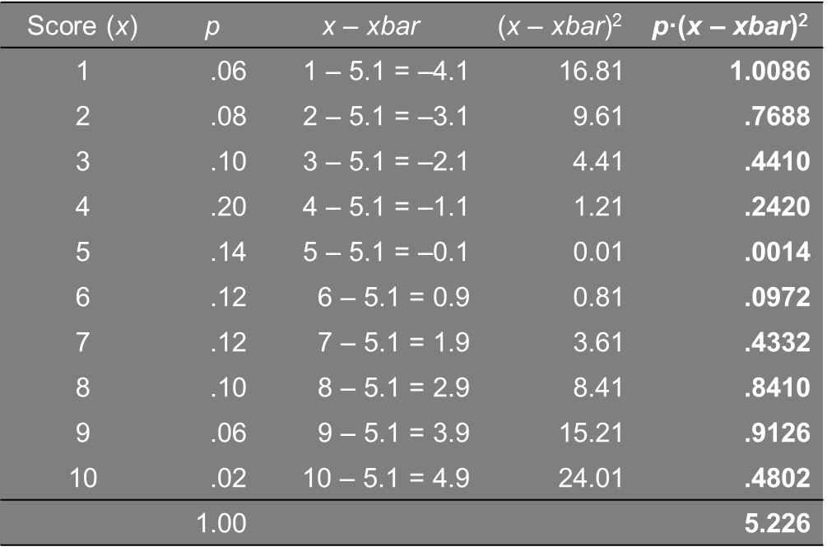
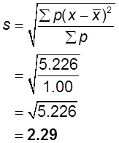
Frequency Distributions (cont.)
Calculate s using p’s (xbar = 5.1)

Slide 58
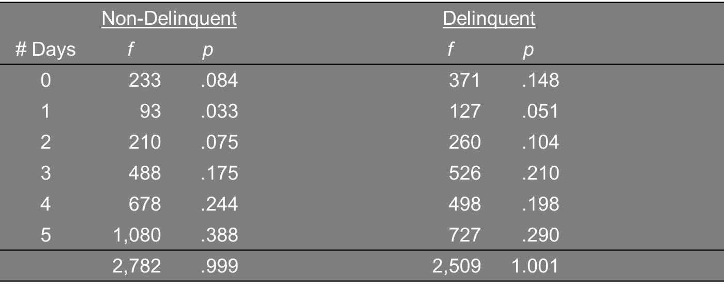
Time Spent on Homework
# of weekdays spent doing homework
For practice, compute measures of central tendency and dispersion

Slide 59
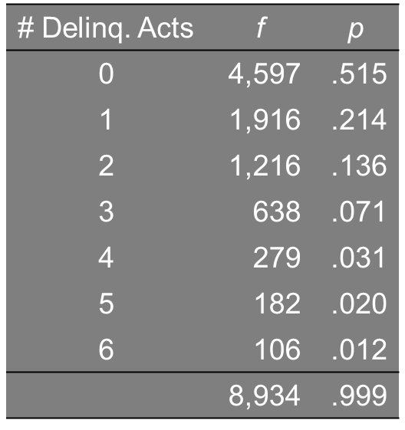
Juvenile Delinquency
Variety scale of six delinquent acts
More practice

Slide 60
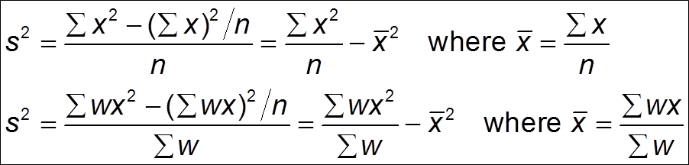
Computational Formula for Variance & Standard Deviation
With a small # of values, the “definitional” formula is fine
With a large # of values, a “computational” or shortcut formula is better
Requires less information (only x & x²)

Slide 61
Sentence Length
Sentence length in months for armed robbery
36 38 39 47 50 51 51 53 55 55
56 57 60 62 63 64 64 66 67 68
69 70 70 70 71 75 78 79 80 80
81 83 85 86 87 89 95 98 99 99
Mode = 70
Median = 68.5
Mean = 68.7
VR = 1 – (3/40) = 1 - .075 = .925
QP = (20 +1) / 2 = 10.5 → IQR = 80.5 – 55.5 = 25.0

Slide 62
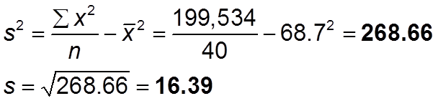
Sentence Length (cont.)
For SD, first square all of the raw values
1296 1444 1521 2209 2500 2601 2601 2809 3025 3025
3136 3249 3600 3844 3969 4096 4096 4356 4489 4624
4761 4900 4900 4900 5041 5625 6084 6241 6400 6400
6561 6889 7225 7396 7569 7921 9025 9604 9801 9801
Sum = 199, 534
Plug the relevant numbers into the formula

Slide 63
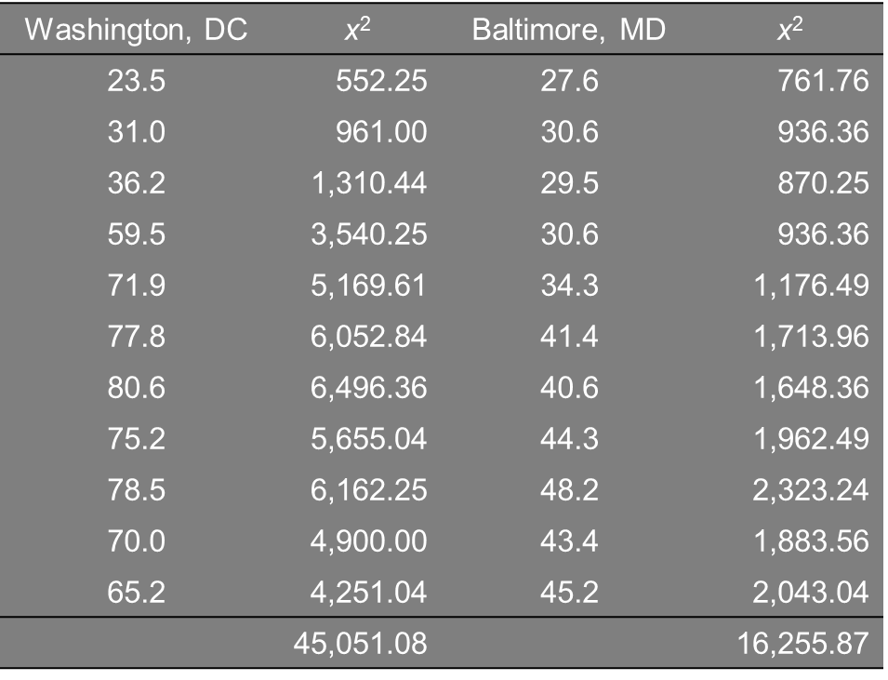
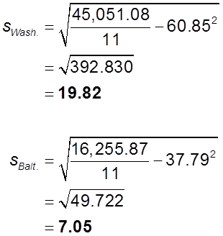
City Homicide Rate
Washington & Baltimore, 1985-1995

Slide 64
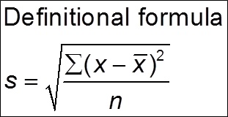
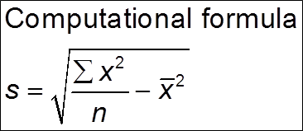
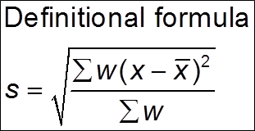
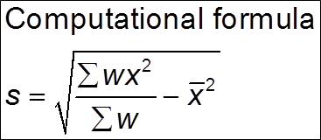
Reviews of Formulas for Standard Deviation
Unweighted data (i.e., raw numbers)
Weighted data (i.e., frequency distribution)

Slide 65


Populations v. Sample Means & Standard Deviations
Population mean & standard deviation
μ = mean; σ = standard deviation
Where N represents the size of the population
Known as population “parameters”
Sample mean & standard deviation
Xbar = mean; s = standard deviation
Where n represents the size of the sample
Known as sample “statistics”

Slide 66
Population v. Sample Means & Standard Deviations (cont.)
For inferential purposes, we want to use sample statistics as estimates of population parameters
Can we use xbar as a valid estimate of μ?
Can we use s as a valid estimate of σ?
Fortunately, xbar provides an unbiased estimate of μ
We say “mu hat,” where the hat signifies an estimate of the true quantity of interest

Slide 67
Population v. Sample Means & Standard Deviations
However, for reasons we will discuss later in the semester s is a biased estimate of σ
We call the term on the right-hand side of the equality “sigma hat”
An unbiased estimate of σ substitutes n-1 in the denominator rather than n

Slide 68
Homework #1
Part I
1) Refer to frequency distribution in this lecture comparing time spent on homework by delinquent status. Compute the following measures of central tendency and dispersion:
a) Mode & median
b) Mean using frequencies as weights
c) Mean using proportions as weights
d) Variation ratio and interquartile range
e) Standard deviation using frequencies as weights
f) Standard deviation using proportions as weights

Slide 69
Homework #1 (cont)
Part I questions (cont.)
2) Refer to the frequency distribution in this lecture showing the delinquency variety score. Compute the following measures of central tendency and dispersion:
a) Mode & median
b) Mean using frequencies as weights
c) Mean using proportions as weights
d) Variation ratio and interquartile range
e) Standard deviation using frequencies as weights
f) Standard deviation using proportions as weights

Slide 70
Homework #1 (cont)
Part 2 data = Homicide rates, 1950-2016
4.6 4.4 4.6 4.5 4.2 4.1 4.1 4.0 4.8 4.9
5.1 4.8 4.6 4.6 4.9 5.1 5.6 6.2 6.9 7.3
7.9 8.6 9.0 9.4 9.8 9.6 8.8 8.8 9.0 9.7
10.2 9.8 9.1 8.3 7.9 8.0 8.6 8.3 8.5 8.7
9.4 9.8 9.3 9.5 9.0 8.2 7.4 6.8 6.3 5.7
5.5 5.6
In order by year from 1950 to 2016 (left to right, top to bottom)

Slide 71
Homework #1 (cont)
Part 2 (cont.)
1) Compute the mode, median, and mean
2) Compute the variation ratio and interquartile range
3) Compute the standard deviation using the definitional formula
4) Compute the standard deviation using the computational formula

